Slide 1
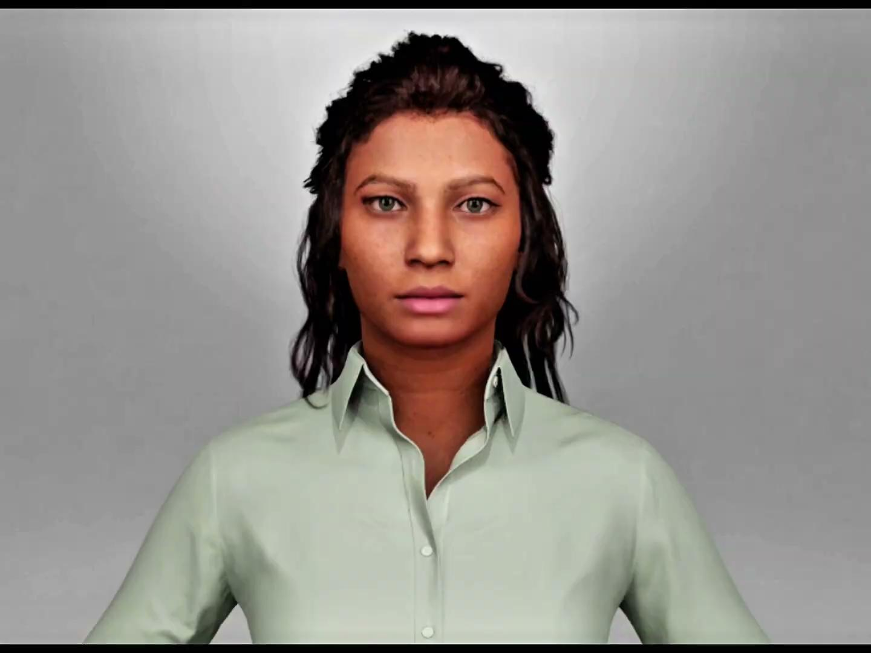
Real-Time Interactive Metahuman Development Using AI
Comparative Study of OpenAI Realtime API vs Local Execution with Whisper SR, ChatGPT (GPT-3.5 Turbo), and OpenAI TTS
COM495 Presentation by Jingjing Chang, Sababa Ahmed, Rahil Aggarwal-Wheeler

Slide 2
Real-Time Interactive Metahuman Development Using AI
Comparative Study of OpenAI Realtime API vs Local Execution with Whisper SR, ChatGPT (GPT-3.5 Turbo), and OpenAI TTS
COM495 Presentation by Jingjing Chang, Sababa Ahmed, Rahil Aggarwal-Wheeler
Advisor: Prof. S. James Lee

Slide 3
Table of contents
01
02
03
04
05
Introduction
Objective, Why Metahumans?
Background
Core Component, Technologies Involved
Methodology
System Design Overview, Implementation Steps, Challenges Faced
Progress and Results
Current Status, Preliminary Comparison
Future Plans
Next Semester Goals, Long-Term Vision

Slide 4
01
Introduction
Objective, Why Metahumans?

Slide 5

Introduction
Objective:
Explore and compare two approaches to developing a real-time interactive metahuman.
Assess performance in human-like communication.
Envision future functional value (e.g., as an educational tutor or healthcare receptionist).
Why Metahumans?
Role in creating lifelike digital avatars for interactive use cases.

Slide 6
02
Background
Core Component, Technologies Involved

Slide 7
Core Components
Speech Recognition | Understanding human speech
Large Language Model (LLM) | Generating contextual, meaningful responses dynamically.
Natural Language Processing (NLP) | Interpreting user intent and improving conversational flow.
Text-to-Speech (TTS) | Converting text to lifelike audio
Audio2Face Integration | Synchronizing speech with metahuman lip movement and expressions.

Slide 8
Technologies Involved
OpenAI Realtime API
ChatGPT Integration
NVIDIA Audio2Face
Unreal Engine + Metahuman
Overview of its functionality and strengths
Features and usage
Importance of audio-visual alignment
Bringing metahuman animations to life.

Slide 9
03
Methodology
Implementation Steps

Slide 10


Two Implementation Steps
OpenAI integrated models Approach
OpenAI Realtime API Approach
Whisper SR, OpenAI GPT-3.5, TTS, NVIDIA Audio2Face, Unreal Metahuman.
API integration for real-time interaction. GPT-4o, NVIDIA Audio2Face, Unreal Metahuman.

Slide 11
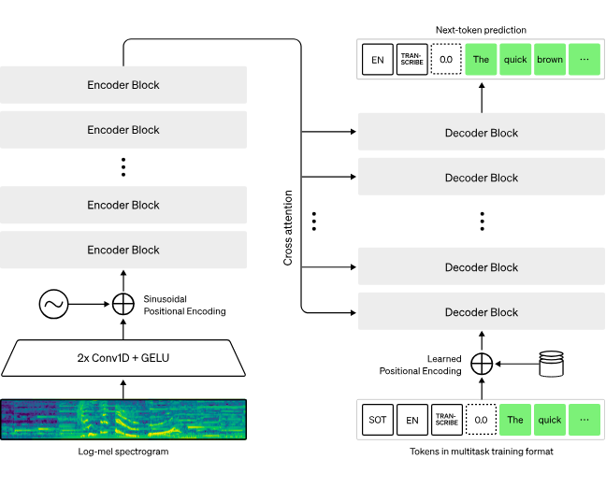
Whisper SR
Whisper is an automatic speech recognition (ASR) system trained on 680,000 hours of multilingual and multitask supervised data collected from the web.
Moreover, it enables transcription in multiple languages, as well as translation from those languages into English.

Slide 12
OpenAI GPT-3.5 VS GPT-4o
GPT-3.5 Turbo
The model follow instructions better, such as making outputs terse or always responding in a given language
GPT-3.5 Turbo can match, or even outperform, base GPT-4-level capabilities on certain narrow tasks
GPT-4o
A step towards much more natural human-computer interaction
It can respond to audio inputs in as little as 232 milliseconds, with an average of 320 milliseconds, which is similar to human response time⁠ in a conversation.

Slide 13
OpenAI TTS
Text Speech
1. Natural and Expressive Speech
• Generates lifelike audio with human-like intonation and clarity.
• Supports multiple languages and customizable voice styles (e.g., tone, pitch).
2. Real-Time and Scalable
• Fast processing for real-time applications like virtual assistants or live translation.
• Handles high-volume text-to-audio tasks efficiently.

Slide 14
Whisper+ChatGPT3.5+OpenAI TTS
M1
M1
(local execution)
Audio
Whisper SR
Audio
Stream
Text
O1
A2F
OpenAI
GPT-3.
Soundstream
Facial animation
Text response
M2
OpenAI
TTS
Metahuman

Slide 15
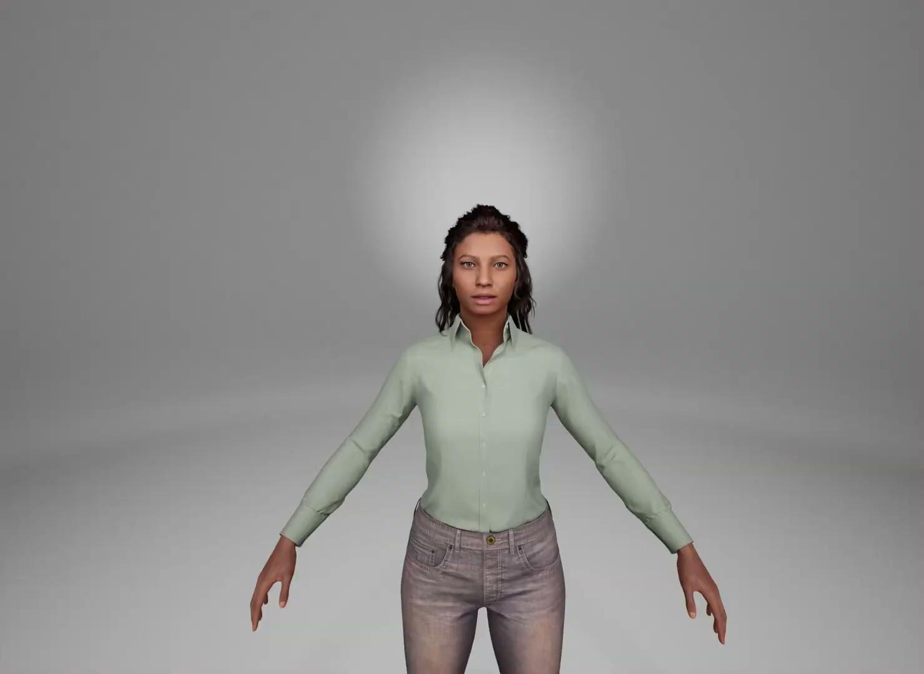
OpenAI Realtime API + Audio2Face Workflow
M1
O2
Audio
OpenAI
(Realtime API)
Audition & text
A2F
M2
Metahuman
Notes:
With GPT-4o, they trained a single new model end-to-end across text, vision, and audio, meaning that all inputs and outputs are processed by the same neural network.

Slide 16
04
Progress and Results
Current Status, Preliminary Comparison

Slide 17
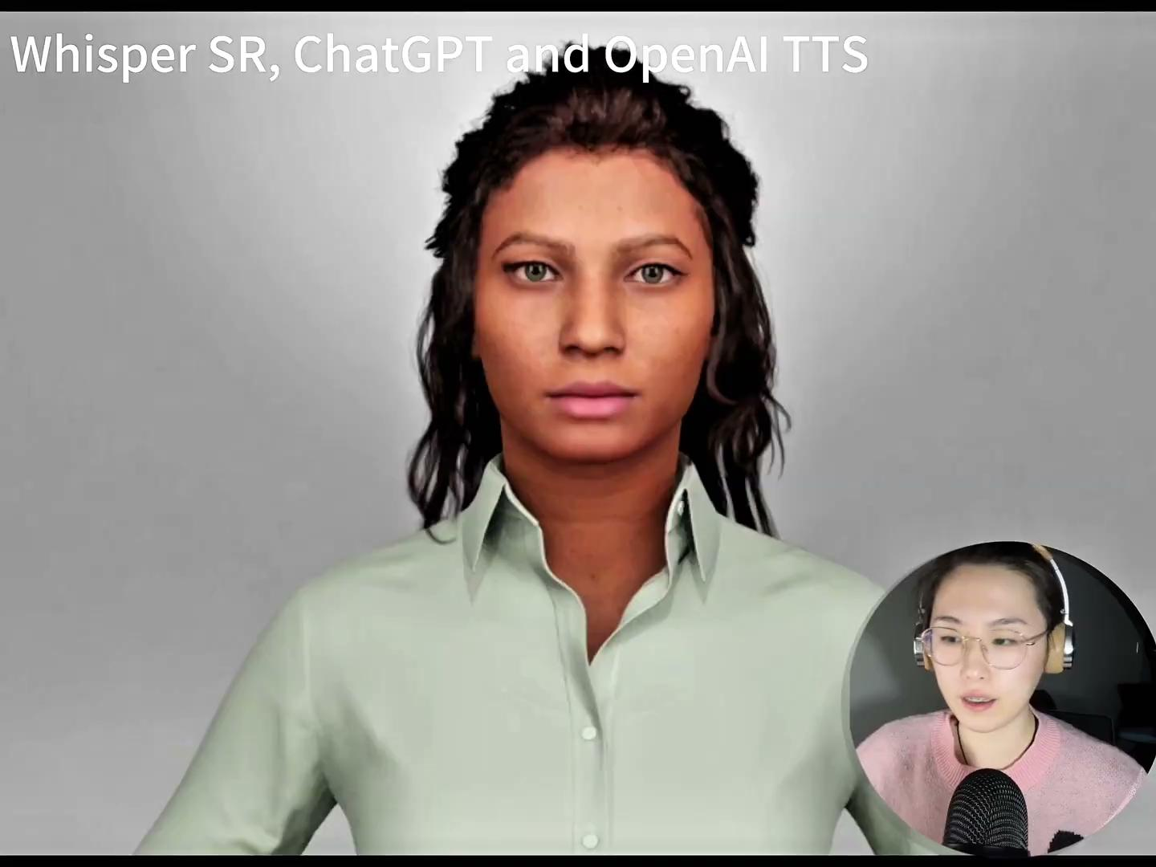
Whisper SR, ChatGPT and OpenAI TTS
Observations: Speech accuracy and response timing.

Slide 18
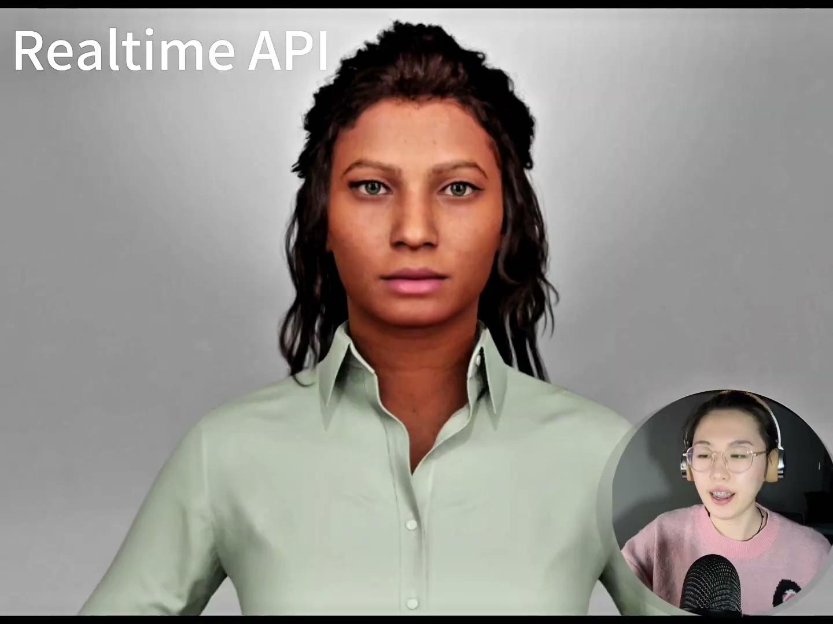
OpenAI Realtime API
Observations: Speech accuracy and response timing.

Slide 19
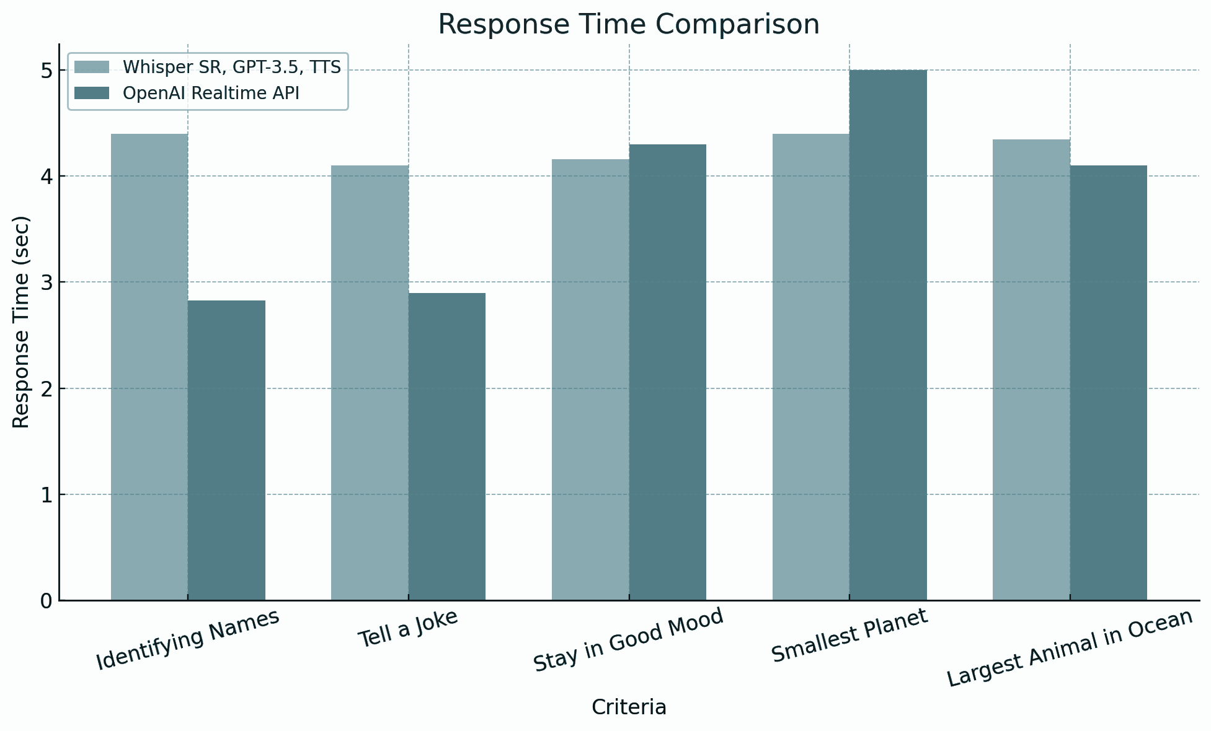
Preliminary Comparison
Speed Comparison:
The OpenAI Realtime API demonstrates faster average response times compared to Whisper, GPT-3.5, and TTS.
Accuracy Comparison:
However, accuracy remains uncertain, as the OpenAI Realtime API showed occasional misrecognitions. Further testing is required to validate its reliability.

Slide 20
Preliminary Comparison
1. Testing Status:
We have not yet begun testing the real-time interaction performance of the two methods on a fully implemented Metahuman model.
The results shared are based on a single demo test, not comprehensive evaluation.
2. Response Quality:
Both methods provide high-quality responses overall. While the speed differs, the content of the responses was satisfactory in the test.

Slide 21
05
Future Plans
Next Semester Goals, Long-Term Vision

Slide 22
Next Semester Goals
Add timing code to the code to get an accurate response time
Compare the working performance of the two methods
Optimizing the metahuman model

Slide 23
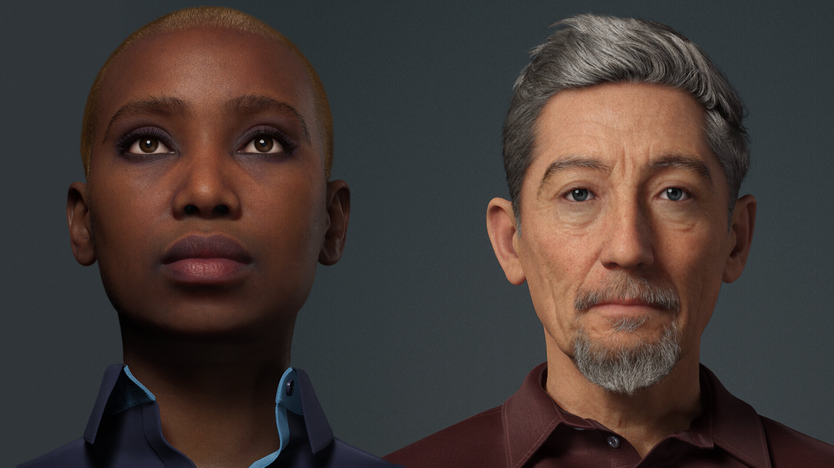
Long-Term Vision
Enhancement of superhuman functioning (e.g., emotional intelligence, tone of voice, timbre, mood).
Potential roles:
Virtual tutors.
Healthcare front desk assistants.

Slide 24
Thanks!
Do you have any questions?

